Slide 1

Leveraging predictability of
Deep Learning techniques on financial time series forecasting
GUIDE NAME: Prof. SARAT CHANDRA NAYAK
PROJECT GROUP: P10-15
SRI VAISHNAVI VASA HU21CSEN0100673
LEENA DEEKOLLU HU21CSEN0100741
BINDU SRI HU21CSEN0101184
GSoT, Computer Science & Engineering

Slide 2
CONTENTS
→OVERVIEW
→ABSTRACT
→PROBLEM STATEMENT
→PROPOSED MODEL
→RESULTS SUMMARY
→MODEL PERFORMANCE RESULTS
→CONCLUSION
GSoT, Computer Science & Engineering

Slide 3
ABSTRACT
Financial time series forecasting is challenging due to market volatility, especially in emerging economies like India. Traditional models struggle with complex, non-linear dependencies. This study proposes a Bi-LSTM + Dense Network model, where Bi-LSTM captures sequential dependencies and Dense layers extract non-temporal relationships, improving predictive accuracy. Extensive experiments with deep learning and probabilistic models highlight challenges in fluctuating stock dynamics. To enhance interpretability, Explainable AI (XAI) techniques are integrated, ensuring transparency in feature significance. The findings demonstrate the effectiveness of combining sequential and non-sequential learning for financial forecasting, contributing to AI-driven financial modeling.
GSoT, Computer Science & Engineering

Slide 4
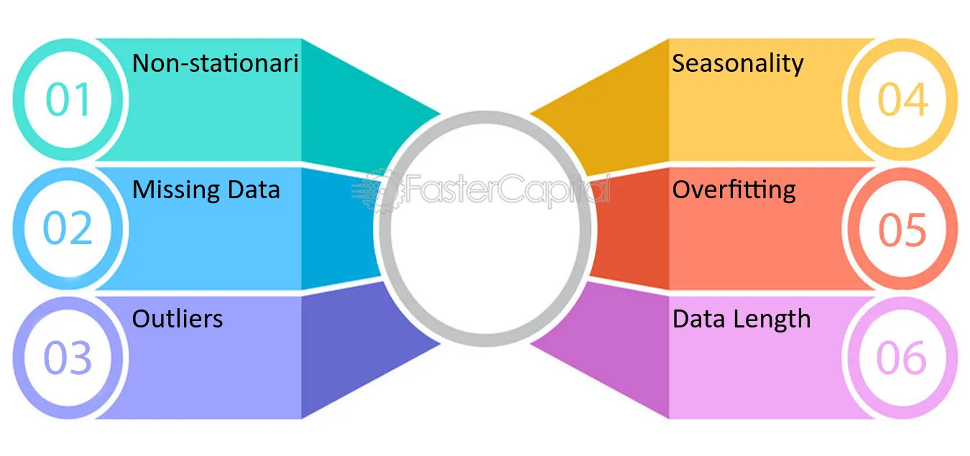
PROBLEM STATEMENT
Stock price prediction is challenging due to market volatility and non-linearity. Traditional models struggle with complex financial patterns, leading to unreliable forecasts, while deep learning remains underexplored in the Indian market. Additionally, most AI models lack interpretability, limiting their adoption in financial decision-making.
This project evaluates a hybrid Bi-LSTM + Dense Network for forecasting stock prices in the Indian market using BSE SENSEX NEXT50 data (2014–2024). By modeling sequential dependencies and integrating Explainable AI (XAI), it aims to enhance predictive accuracy and transparency, improving trust in AI-driven forecasts.
Fig 1: Challenges and Limitations of Time Series Analysis
(Source: https://fastercapital.com/topics/challenges-and-limitations-of-time-series-analysis.html)
GSoT, Computer Science & Engineering

Slide 5
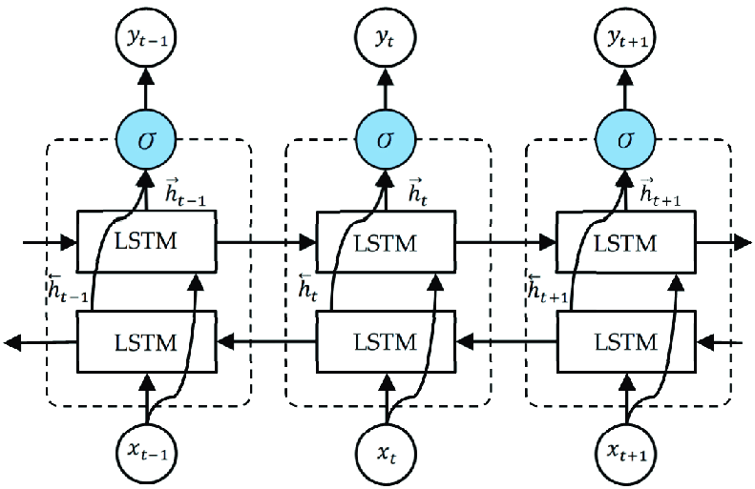
BI LSTM (BI-DIRECTIONAL LSTM)
Bi-LSTM (Bidirectional Long Short-Term Memory) is a recurrent neural network architecture that enhances traditional LSTM models by processing input sequences in both forward and backward directions which helps to capture both past and future context
Architecture Highlights:
Two LSTM Layers
Concatenation of Outputs
Memory Cells
Fig 2: Working of Bi-LSTM model
(Source: https://www.researchgate.net/figure/The-unfolded-architecture-of-Bidirectional-LSTM-BiLSTM-with-three-consecutive-steps_fig2_344751031)
GSoT, Computer Science & Engineering

Slide 6
For each time step t:
Forget gate: f_{t}=σ(W_{f}x_{t}+U_{f}h_{t−1}+b_{f}) → Decides what to forget
Input gate: i_{t}=σ(W_{i}x_{t}+U_{i}h_{t−1}+b_{i}) → Controls new memory updates
Cell state update: c_{t}=f_{t}⊙c_{t−1}+i_{t}⊙ĉ_{t} where ĉ_{t} =tanh(W_{c}x_{t}+U_{c}h_{t−1}+b_{c})
Output gate: o_{t}=σ(W_{o}x_{t}+U_{o}h_{t−1}+b_{o}) → Determines final hidden state h_{t}=o_{t}⊙tanh(c_{t})
In Bi-LSTM, a second LSTM runs backward, producing another hidden state h_{t}^{b}. The final output is the concatenation:
h_{t}=[h_{t}^{f},h_{t}^{b}]
Explanation of Terms:
x_{t}: Input at time t.
h_{t}: Hidden state (memory of LSTM).
c_{t}: Cell state (stores long-term memory).
σ (Sigmoid): Activation function that outputs values between 0 and 1.
tanh: Activation function that outputs values between -1 and 1.
W,U,b: Trainable weight matrices and biases.
GSoT, Computer Science & Engineering

Slide 7
DENSE NETWORK
A Dense Network, also called a Fully Connected (FC) Network, is a type of neural network where each neuron in one layer is connected to every neuron in the next layer.
The architecture consists of:-
Input Layer → Receives raw data
Hidden Layers → Apply linear transformations with non-linear activations (e.g., ReLU, Sigmoid) to extract features
Output Layer → Generates the final prediction using an appropriate activation function (e.g., Softmax for classification, Linear for regression).
Fig 3: Working of Dense Network model
(Source: https://machinelearningknowledge.ai/keras-dense-layer-explained-for-beginners/)
GSoT, Computer Science & Engineering

Slide 8
A Dense Network (Fully Connected Neural Network) can be mathematically represented as follows:
For a given layer l, the output h^{(l)} is computed as:
h^{(l)}=f(W^{(l)}h^{(l−1)}+b^{(l)})
where:
h^{(l)} = output of layer l (activations)
W^{(l)} = weight matrix of layer l
h^{(l−1)}= input from the previous layer
b^{(l)} = bias vector of layer l
f(⋅) = activation function (e.g., ReLU, Sigmoid, Tanh)
For multi-layer networks, this equation is applied iteratively across all layers until the output layer produces the final prediction.
GSoT, Computer Science & Engineering

Slide 9
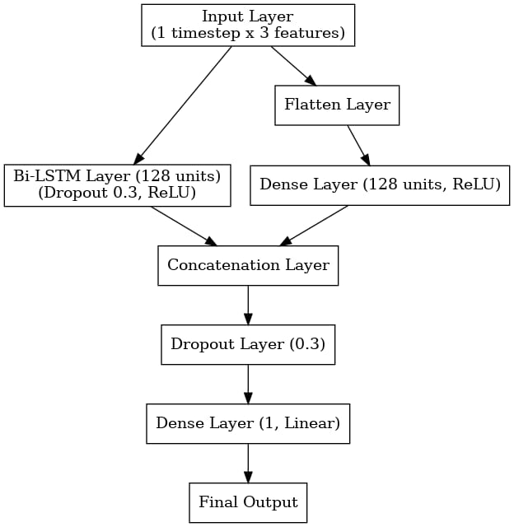
BI LSTM + DENSE NETWORK
This model integrates Bi-LSTM and Dense layers to capture both sequential and static features, enhancing predictive performance. This model effectively captures both temporal dependencies and feature-based representations to improve forecasting accuracy.
Bi-LSTM Layer: Captures temporal dependencies in both directions.
Dense Layer: Learns static feature representations.
Concatenation Layer: Merges Bi-LSTM and Dense outputs.
Dropout : Reduces overfitting.
Final Dense: Outputs the final prediction.
Fig 4: Architecture flowchart of
Bi LSTM + Dense Network model
GSoT, Computer Science & Engineering

Slide 10
FEATURE | BI-LSTM ONLY | DENSE NETWORK | BI-LSTM + DENSE NETWORK (HYBRID MODEL)
Sequential Learning | Captures temporal dependencies well but lacks transformation for final predictions. | Cannot handle sequential data effectively. | Learns sequential patterns via Bi-LSTM and refines them with Dense layers.
Feature Extraction | Extracts temporal features but may not generalize well. | Good at nonlinear transformations but fails on sequences. | Combines Bi-LSTM’s memory with Dense layers' feature refinement.
Prediction Accuracy | May struggle with final classification or regression. | Limited in handling time-dependent relationships. | Achieves superior accuracy by balancing sequence learning and feature extraction.
Efficiency & Generalization | Computationally expensive and prone to overfitting. | Efficient but lacks memory for past data. | Optimized for better generalization and efficient learning.
GSoT, Computer Science & Engineering

Slide 11
CODE WORKFLOW
BAYESIAN OPTIMIZATION
Bi LSTM BRANCH
Dense Net BRANCH
CONCATENATE
FINAL LAYER
The input data (features Open, High, Low) is first processed by the Bi-LSTM layer. This layer captures the temporal dependencies from the time-series data.
The output of the Bi-LSTM layer is a vector (size 64), which represents the sequential information extracted from the input data.
The input data (features Open, High, Low) is processed by a fully connected Dense network, which captures non-sequential feature interactions.
The output of the Dense network is a vector (size 32), which represents the extracted feature embeddings from the input data.
The output vectors from the Bi-LSTM and Dense network are concatenated to form a unified representation (size 96).
The concatenated feature vector is passed to a final Dense layer, which predicts the target stock price based on the combined learned information.
Bayesian Optimization is used to fine-tune hyperparameters such as learning rate, number of units in Bi-LSTM, and dropout rate, ensuring optimal model performance.
It iteratively selects hyperparameters by balancing exploration and exploitation, leading to a more efficient search compared to random or grid search methods.
The concatenated feature vector (size 96) is passed through a Dense layer with an appropriate activation function to generate the final stock price prediction.
This layer maps the learned feature representation to the target output, minimizing the error using a loss function like Mean Squared Error (MSE).
GSoT, Computer Science & Engineering

Slide 12
BASELINE MODELS PERFORMANCE
MODEL | MAE | MSE | RMSE | MAPE
CNN 1D | 1595.166 | 3251346.784 | 1803.149 | 1.8555
CNN 2D | 4795.0616 | 26595498.78 | 5157.0824 | 0.0552
CNN 3D | 1461.777 | 3466656.749 | 1861.896 | 1.7162
RNN | 8096.682617 | 67347192 | 8206.533495 | 9.356794506
LSTM | 416.4977292 | 340800.3986 | 583.7811222 | 0.4892616974
GRU | 397.408099 | 306645.694 | 553.7559878 | 0.4667090316
BI-LSTM | 380.599901 | 284154.2677 | 533.0612232 | 0.4468173881
Transformer | 85759.98959 | 7358908989 | 85784.08354 | 99.91529682
GNN | 27714.57227 | 773981696 | 27820.52652 | 32.25002587
ResNet | 7633.982422 | 59255288 | 7697.745644 | 8.877309412
GSoT, Computer Science & Engineering

Slide 13
Continued….
MODEL | MAE | MSE | RMSE | MAPE
ARIMA | 15,953 | 331024114.1 | 18194.068 | 18.604
SARIMA | 1579.235 | 4781679.57 | 2186.705 | 1.87
GARCH | 1236381.378 | 2167756545440 | 1472330.311 | 123603259.6
Exponential Smoothing | 50635.80787 | 2571024935 | 50705.27522 | 58.97303409
Prophet | 42244.67284 | 1791620621 | 42327.53974 | 49.2
TimesNet | 22276.50127 | 496755979.9 | 22288.02324 | 25.95059166
DeepAR | 2931.89899 | 13482604.07 | 3671.866565 | 3.409159372
CNN 3D + TimesNet | 2844.834344 | 8394004.208 | 2897.240792 | 3.319919793
TimesNet + GRU | 401.7646823 | 315859.1239 | 562.0134552 | 0.4725300889
TimesNet + Bi LSTM | 60350.9603 | 3644292459.2 | 60367.9754 | 0.7030
GSoT, Computer Science & Engineering

Slide 14
PROPOSED MODEL : BI LSTM + DENSE NETWORK
MAE
399.017
MSE
301999.74
The low MAE suggests that the average error (absolute deviation) between predicted and actual values is minimal, showing consistent performance across predictions.
The model's low MSE indicates that it avoids large deviations between predicted and actual stock prices better than other models.
RMSE
549.54
MAPE
0.469
Its low RMSE confirms that large errors are effectively minimized.
This indicates that the model’s predictions are highly accurate relative to the scale of the data.
GSoT, Computer Science & Engineering

Slide 15
PROPOSED MODEL PERFORMANCE
METRIC | PROPOSED MODEL | BEST VALUE FROM BASELINE MODELS | CORRESPONDING BASELINE MODEL
MAE | 399.0173 | 397.4080 | GRU
MSE | 301999.742 | 301999.742 | GRU
RMSE | 549.545 | 553.7559 | GRU
MAPE | 0.469 | 0.05 | CNN 3D
Significantly Lower MAE, MSE, and RMSE
Comparable MAPE
Better Overall Performance for Real-World Applications
GSoT, Computer Science & Engineering

Slide 16
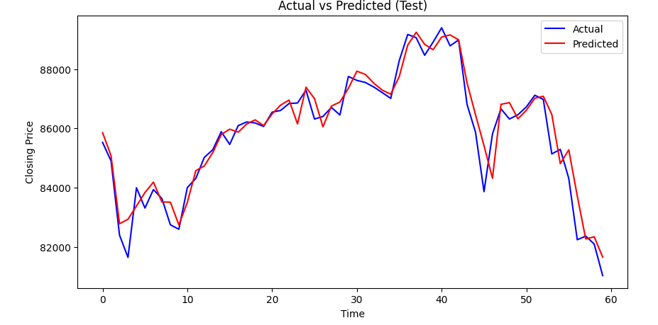
Fig 5: Actual vs predicted Stock price values for the hybrid model: Bi-LSTM+Dense Network
The graph shows a strong correlation between actual and predicted closing prices, indicating that the model performs well in capturing trends. However, minor deviations suggest some prediction errors, which could be improved with further tuning.
GSoT, Computer Science & Engineering

Slide 17
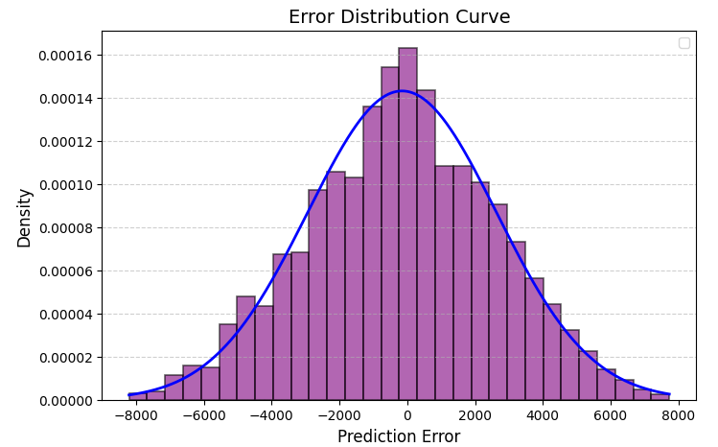
Fig 6: Error distribution of model’s predictions
The error distribution curve follows a normal distribution, indicating that the model's prediction errors are mostly centered around zero. However, the presence of outliers suggests some variance, which may require further optimization.
GSoT, Computer Science & Engineering

Slide 18
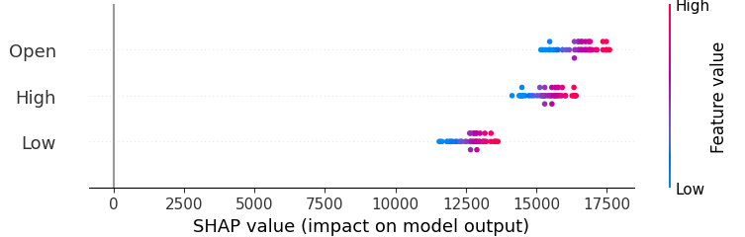
Fig 7: SHAP Summary Plot for determining feature importance
The SHAP value plot shows that the features "Open," "High," and "Low" do not contribute equally to the model's predictions. "Open" has the highest impact, followed by "High" and then "Low," as indicated by the spread and magnitude of their SHAP values.
GSoT, Computer Science & Engineering

Slide 19
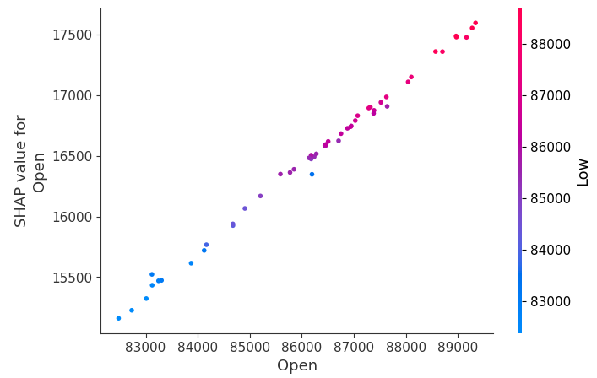
Fig 8: SHAP Dependence Plot for determining feature importance
The SHAP value for the "Open" feature shows a strong linear relationship with its actual value, indicating a direct and significant contribution to the model's predictions. The color gradient suggests that "Low" values also influence the SHAP values, but "Open" remains the primary driver.
GSoT, Computer Science & Engineering

Slide 20
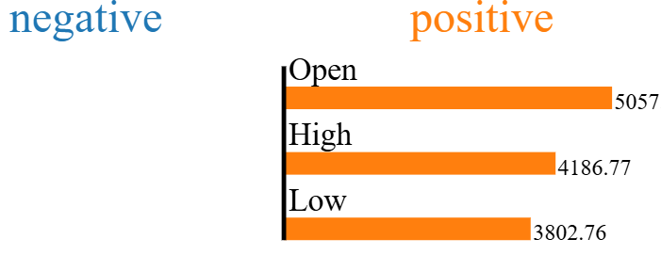
Fig 9: LIME Explanation Chart to determine positive and negative feature contribution
Positive contributions indicate that the feature increases the model's predicted value, while negative contributions decrease it. In this graph, "Open" has the highest positive impact on the prediction, followed by "High" and "Low," suggesting that these features significantly drive the model's output in a positive direction. The absence of negative contributions implies that no feature strongly pushes the prediction downward.
GSoT, Computer Science & Engineering

Slide 21
CONCLUSION
The proposed model demonstrates strong predictive accuracy, as evident from its close alignment with actual stock prices and well-behaved loss curves.
The low training and validation loss indicate that the model effectively minimizes error without overfitting.
The prediction error follows a normal distribution, further validating the reliability of the model's forecasts.
While minor deviations exist in extreme stock price fluctuations, overall, the model is robust and provides high-quality predictions.
The proposed model provides the best trade-off between accuracy and generalization, making it a superior choice for real-world time series forecasting. It achieves the lowest MAE, MSE, and RMSE while maintaining a reasonable MAPE, outperforming state-of-the-art models in the table.
GSoT, Computer Science & Engineering

Slide 22
CHALLENGES
Not all models are designed for time-series data like stock prices and may not capture temporal dependencies effectively.
Evaluation Metrics Misalignment
Metrics like RMSE or MAPE can vary significantly across models depending on the nature of predictions (e.g., scale, bias towards larger values).
Model Suitability
Some models are sensitive to hyperparameter choices like learning rate, batch size, and number of layers.
Complex models might overfit the training data, resulting in poor generalization and high errors on the test set.
Hyperparameter Tuning
Overfitting
Stock market data often contains noise, non-stationarity, and sudden jumps (due to market events).
Some complex models require substantial data and training time and if trained on limited stock data or for a short time, they might underperform.
Dataset Characteristics
Training Duration
GSoT, Computer Science & Engineering

Slide 23
SCOPE FOR FUTURE WORK
Enhancing Feature Selection – Incorporating additional market indicators (e.g., trading volume, macroeconomic indicators) to further refine predictions.
Fine-Tuning Hyperparameters – Experimenting with different architectures, learning rates, and regularization techniques to improve performance.
Reducing Error on Extreme Fluctuations – Implementing advanced techniques like attention mechanisms or ensemble learning to capture rare market behaviors.
Exploring Alternative Loss Functions – Investigating asymmetric loss functions that penalize high-magnitude errors more aggressively.
Real-Time Implementation – Deploying the model for live market prediction with real-time data streams to assess its robustness in practical applications.
GSoT, Computer Science & Engineering

Slide 24
Thank You
GSoT, Computer Science & Engineering

